Slide 1


SMART INDIA HACKATHON 2025
TITLE PAGE
Problem Statement ID –SIH25013
Problem Statement Title- Real-Time Public Transport Tracking for Small Cities
Theme- Transportation & Logistics
PS Category- Software
Team ID- 68635
Team Name: Next Stop

Slide 2
IDEA TITLE
Your Team Name
Next Stop
Idea:
Real-time bus tracking ecosystem tailored for small & tier-2 cities.
Unified driver, commuter, and admin interfaces for seamless integration.
GPS-driven ETA engine ensures predictable arrivals.
Lightweight architecture for low-data consumption.
Multi-platform support (Android, iOS, Web)
Problem Resolution:
Eliminates time wastage & uncertainty at bus stops.
Prevents chaotic overcrowding through transparent schedules.
Unique Value Proposition:
Low-bandwidth resilience
Low resource: 50–60 mAh/hr battery, 5–20 MB/hr data usage
Authority insights via analytics

Slide 3
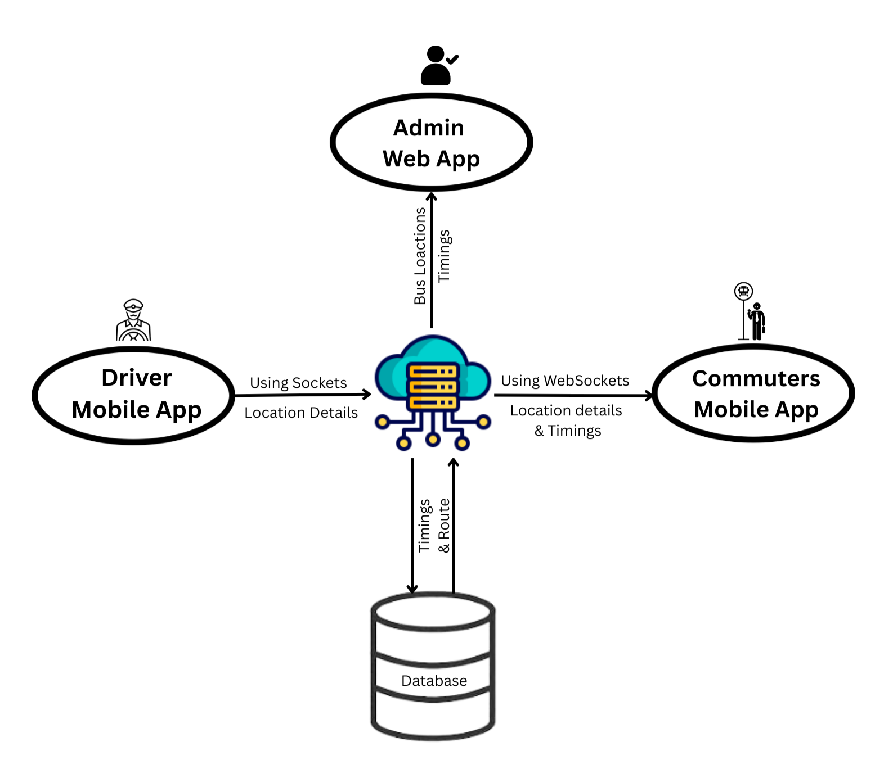
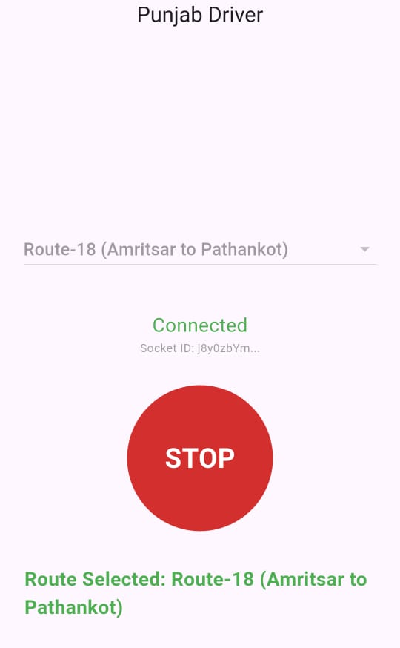
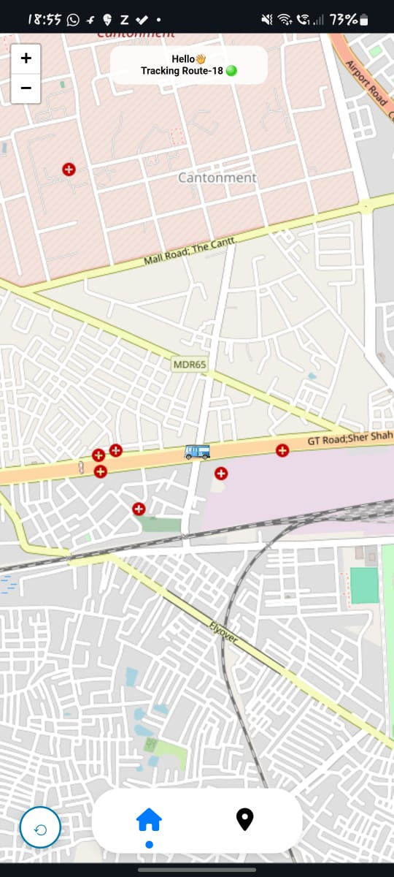
TECHNICAL APPROACH
Your Team Name
Next Stop
Tech Stack
Flutter: cross-platform agility with a single codebase for smooth commuter and driver experience.
FastAPI: lightweight, scalable real-time engine for fast responses.
SQLite: scales seamlessly from pilot setups to city-wide deployments.
OpenStreetMap: accurate ETAs and route visualization with local relevance.
ARCHITECTURE
Prototype🔗

Slide 4
FEASIBILITY AND VIABILITY
Your Team Name
Next Stop
Feasibility:
Technical: GPS + cloud proven & cost-efficient.
Operational: Minimal driver input
Economic: Low-cost architecture; scalable ROI.
Social: Builds commuter trust & reliability.
Challenges & Mitigation:
Network blind spots: use hybrid fallback offline caching + SMS alerts.
Driver reluctance: frictionless driver-first UX with auto-start & battery optimization.
Budget: pilot-first rollout to prove ROI & secure buy-in.
Hardware costs: leverage public-private partnerships for cost-sharing.
Viability Enhancers:
Works on existing smartphones no infra needed.
Upgradeable to GPS IoT devices if required.
Cloud-first, modular APIs for future integrations.

Slide 5
IMPACT AND BENEFITS
Your Team Name
Next Stop
Commuters
Saves time & reduces uncertainty.
Improves safety & convenience.
Builds trust in public transport.
Authorities
Data-driven fleet optimization.
Reduced inefficiencies & costs.
Predictive analytics for planning..
Environment
Reduced dependency on private vehicles.
Lower traffic congestion.
Decrease in CO₂ emissions.
Cities
Aligns with Smart City mission.
Strengthens digital infrastructure.
Creates a sustainable, scalable mobility model.

Slide 6
RESEARCH AND REFERENCES
Next Stop
Urban Mobility India Report 2024 – inefficiencies in tier-2 transport.
NITI Aayog 2023 – 60%+ commuters delayed without real-time data.
Case Study: Indore iBus, Hyderabad TSRTC apps – adoption success.
World Bank Transport Studies – urban mobility in developing regions.
Research papers on GPS-based transit tracking in low-bandwidth contexts.
Open-source examples (Transit APIs, Leaflet.js, OSM).
Smart City policy papers on digital mobility infrastructure.

